Slide 1
Stakeholder consultation meeting on
FABEC RP3 performance plan
Luxembourg, 5 September 2019

Slide 2
Stakeholder consultation meeting on
FABEC RP3 performance plan
Pierre Jaeger
DGCA Luxembourg
Welcome
Luxembourg, 5 September 2019

Slide 3
Stakeholder consultation meeting on
FABEC RP3 performance plan
Ference van Ham, NL NSA
Chairman FABEC FPC
Setting the Scene
Luxembourg, 5 September 2019

Slide 4
Purpose of the day
Performance and charging regulation, Article 10(4):
“In accordance with Article 10(1) and point (b) of Article 11(3) of Regulation (EC) No 549/2004, national supervisory authorities shall consult air navigation service providers, airspace users' representatives and, where relevant, airport operators and airport coordinators on the draft performance plans, including on the performance targets and incentive schemes contained therein.”
This consultation meeting focuses on the FABEC elements of the RP3 performance plan:
Safety
Environment
En route capacity, including the incentive scheme
Cost efficiency and terminal capacity elements are a national responsibility and have been consulted by the FABEC States at the national level

Slide 5
Why a FABEC performance plan?
The FABEC Council decided in December 2017 to maintain performance planning at FAB level
Benefits of coordination and cooperation on performance
Better understanding of each other’s performance status and underlying drivers
Better and earlier awareness of planned activities (airspace, HR, technology)
Increased possibility for identification of opportunities for coordinated or even common actitivies
Coordination and cooperation at FAB level does not mean all activities are defined and executed together!
Compare national level in larger States with multiple area control centres: different centres operate in different environments and face different issues, which can require different solutions or different timelines for similar solutions
FABEC added value is included in proposed RP3 performance target

Slide 6
Development process of the FABEC plan
Performance plan has been developed by the FABEC States’ Financial and Performance Committee
Coordinated with other States’ Committees as required
FABEC NSAs have worked closely with FABEC ANSPs to gather required inputs and to understand plans, ambitions, uncertainties and expectations
NSAs have aimed to propose targets that are ambitious and achievable:
States want ANSPs to deliver the set targets, but there is no purpose to setting targets that cannot be achieved
FABEC Council has given its provisional approval to the targets presented today – pending stakeholder consultation

Slide 7
Approach to the consultation
Proposed targets in the key performance safety, environment and en route capacity, as well as the en route capacity incentive scheme, will be presented by the FABEC NSAs
At the end of each presentation there will be time for questions and comments
ANSP experts are available to answer questions from other stakeholders on detailed operational issues or plans, if necessary
Cost efficiency is presented for information and completeness only; details have been consulted at national level – no questions or comments are foreseen today
Stakeholder groups will be able to present general views and comments in the afternoon
Following the meeting, FABEC NSAs will consider stakeholder comments and, if appropriate, adapt proposed targets which will be proposed to the FABEC Council for final approval
Additional, written stakeholder comments following the meeting are welcome, if received by 10 September at the latest

Slide 8
Stakeholder consultation meeting on
FABEC RP3 performance plan
Björn Schräder, LU NSA
Safety
Luxembourg, 5 September 2019

Slide 9
Key performance indicator definition
KPI definition (annex 1, section 1, paragraph 1.1 of (EU) 2019/317)
“The minimum level of the effectiveness of safety management to be achieved by air navigation service providers certified to provide air traffic services. This KPI measures the level of implementation of the following safety management objectives:
(a) safety policy and objectives;
(b) safety risk management;
(c) safety assurance;
(d) safety promotion;
(e) safety culture.”

Slide 10
EU-wide targets
Commission implementing decision (EU) 2019/903 of 29 May 2019
setting the Union-wide performance targets for the air traffic management network for the third reference period starting on 1 January 2020 and ending on 31 December 2024.
at least Level C in the safety management objectives ‘safety culture’, ‘safety policy and objectives’, ‘safety assurance’, and ‘safety promotion’;
at least Level D in the safety management objective ‘safety risk management’.
[level C = “Managed” – level D = “Assured”]

Slide 11
EC statement on performance plans assessment
(EU) 2019/317:
Article 14.1:
“The Commission shall assess the consistency of the national performance targets or FAB performance targets … taking into account local circumstances.”
Annex IV, 1.1 Criteria for safety assessment:
“… the level of effectiveness of safety management is equal to, or higher than, the corresponding Union-wide performance targets.“

Slide 12
RP2 FABEC actual safety achievements
In RP2 States and ANSPs are subject to three KPIs (#1 Level of Effectiveness of Safety Management, #2 Application of the severity classification based on the Risk Analysis Tool (RAT) methodology, #3 Just Culture) whereas RP3 obliges the ANSPs only to measure its EoSM.
The RP2 EASA questionnaire differs from the new RP3 CANSO SoE based questionnaire and hence a meaningful comparison of current performance in relation to RP3 targets is complex. The current ANSPs’ RP2 EoSM achievements are as follows:
ANSPs already reached the target level C for the Management Objective (MO) Safety Culture;
For all other MOs ANSPs have achieved at least level C (target level D);
Within the permanent supervision NSAs have informed ANSPs where they have to improve until then end of RP2/2019;
RP2 targets are expected to be achieved by all FABEC ANSPs at the end of this year.
[source: FABEC monitoring report 2018]

Slide 13
RP3 Safety: towards target setting
Uncertainties to be considered
The “Development of acceptable means of compliance and guidance material for safety key performance indicators and other safety performance indicators The ATM Performance Scheme Implementing Regulation” (EASA RMT.0723):
Unexpected issues between EASA and the Commission concerning status;
Progress is slow (NPA foreseen in early summer);
CRD → Opinion/Decision outstanding;
AMC/GM necessary to assess the ANSPs’ EoSM.

Slide 14
Proposed FABEC targets for RP3
FABEC States considerations:
NSAs already consulted ANSPs in February and March 2019 including bilateral discussions in the NSAC #28 in Luxembourg. Taking the ANSPs’ feedback into account, the NSAs determined to stick to the Union-wide targets;
EU wide targets are feasible due to current and recent performance;
RP2 achievements (end of 2019) will be a solid basis to reach the targets in RP3 (end of 2024);
ANSPs are already familiar with the basic content of the new questionnaire (CANSO SoE);
NSAs supervise the RP3 performance permanently (NSAC → SPRC TF) and can intervene if the RP3 targets’ achievement is in danger.

Slide 15
Main measures put in place to achieve the safety performance targets
Regular exchange amongst experts in the FABEC Safety Performance and Risk Coordination (SPRC) TF three times a year as permanent agenda item;
Furthermore, within the yearly FABEC Performance Monitoring Reporting (Report) EoSM results of the previous year are gathered and monitored: Weaknesses / major discrepancies will be spotted and counteracted by the responsible six NSAs;
Improved cooperation between NSAs and ANSPs in RP3 by strengthening the linkage NSAC (→ SPRC TF) – SC-SAF.

Slide 16
Thank you for your attention
Questions?

Slide 17
Stakeholder consultation meeting on
FABEC RP3 performance plan
Mathias Schallnus, DE NSA
Environment
Luxembourg, 5 September 2019

Slide 18
Key Performance Indicator Horizontal En Route Flight Efficiency
IR (EU) 2019/317 Annex 1 2. Environment
2.1.a) “the indicator is the comparison between the length of the en route part of the actual trajectory derived from surveillance data and the achieved distance, summed over IFR flights within or traversing the airspace as defined in Article 1, hereinafter referred to as ‘European airspace’;”
https://ansperformance.eu/methodology/horizontal-flight-efficiency-pi/
Notes:
Key performance indicators
This KPI measures the average horizontal en route flight efficiency of the actual trajectory, calculated as follows:
(a) the indicator is the comparison between the length of the en route part of the actual trajectory derived from
surveillance data and the achieved distance, summed over IFR flights within or traversing the airspace as
defined in Article 1, hereinafter referred to as ‘European airspace’;
(b) ‘en route part’ refers to the distance flown outside a circle of 40 NM around the airports;
(c) where a flight departs from or arrives at an airport outside the European airspace, the entry or exit points of
the European airspace are used for the calculation of this indicator as the origin or destination respectively,
rather than the departure or destination airport;
(d) where a flight departs from and arrives at an airport inside the European airspace and crosses a non-European
airspace, only the part inside the European airspace is used for the calculation of this indicator;
(e) ‘achieved distance’ is a function of the position of the entry and exit points of the flight into and out of each
portion of airspace for all parts of the trajectory. Achieved distance represents the contribution that those
points make to the great circle distance between origin and destination of the flight;
(f) the indicator is calculated for the whole calendar year and for each year of the reference period, as an average.
When calculating this average, the ten highest daily values and the ten lowest daily values are excluded from
the calculation.

Slide 19
EU-wide Environment Performance Targets
FABEC / ANSPs NM Reference Values (RV)
EU wide targets :
Commission implementing decision (EU) 2019/903 of 29 May 2019 setting the Union-wide performance targets for the air traffic management network for the third reference period starting on 1 January 2020 and ending on 31 December 2024.
Reference values: Local environment reference values for RP3 published by the Network Manager on 5 July 2019
Min/flight | 2020 | 2021 | 2022 | 2023 | 2024
EU wide | 2,53% | 2,47% | 2,40% | 2,40% | 2,40%
FABEC RV | 2,90% | 2,83% | 2,75% | 2,75% | 2,75%
SKEYES RV | 7.09% | 7.09% | 7.05% | 7.05% | 7.05%
DFS RV | 2.81% | 2.73% | 2.65% | 2.65% | 2.65%
DSNA RV | 2.90% | 2.83% | 2.75% | 2.75% | 2.75%
LVNL RV | 7.22% | 7.20% | 7.18% | 7.18% | 7.18%
MUAC RV | 1.99% | 1.92% | 1.85% | 1.85% | 1.85%
SKYGUIDE RV | 4.62% | 4.53% | 4.45% | 4.45% | 4.45%

Slide 20
EC statement on performance plans assessment
(EU) 2019/317:
Article 14.1: “ The Commission shall assess the consistency of the national performance targets or FAB performance targets contained in the draft performance plans with the Union-wide performance targets on the basis of the criteria laid down in point 1 of Annex IV, and taking into account local circumstances.
Annex IV, 1.2 Criteria for environment assessment: “Consistency of national performance targets or FAB performance targets with Union-wide performance targets for each calendar year of the reference period, by comparing the national performance targets or FAB performance targets with en route horizontal flight efficiency reference values set out in latest version of the European Route
Network Improvement Plan available at the time of adoption of the Union-wide performance targets. “
SSC 71 EC Statement:
“The Commission will take local circumstances into account when assessing the consistency of proposed national or FAB targets with the Union-wide targets. Such local circumstances may lead to setting capacity targets in some areas which differ from the reference values calculated by the Network Manager, provided that there is a clear indication that the capacity situation in those areas will improve to accommodate the capacity demand at local and network levels.”

Slide 21
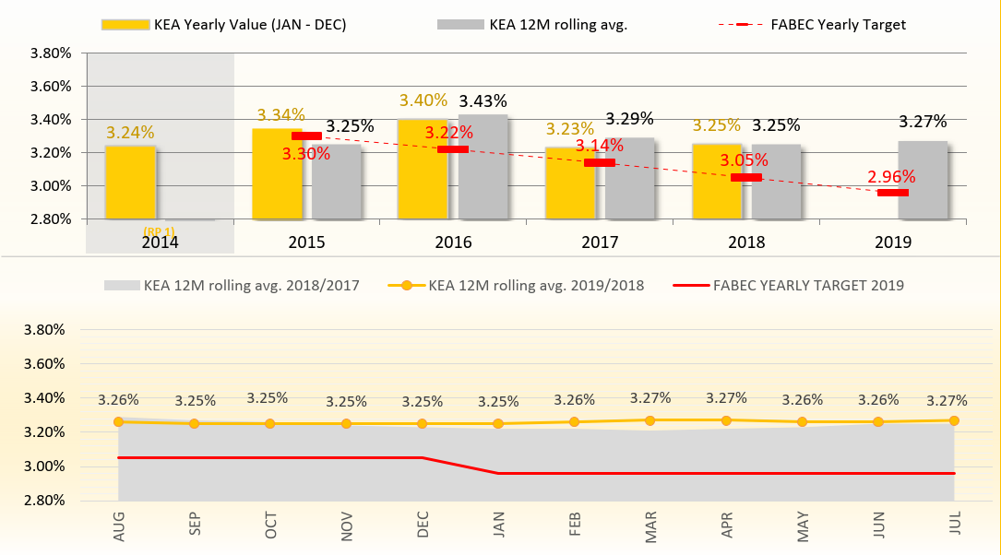
FABEC RP2 Achievements
RV RP3 2,9 – 2,75%

Slide 22
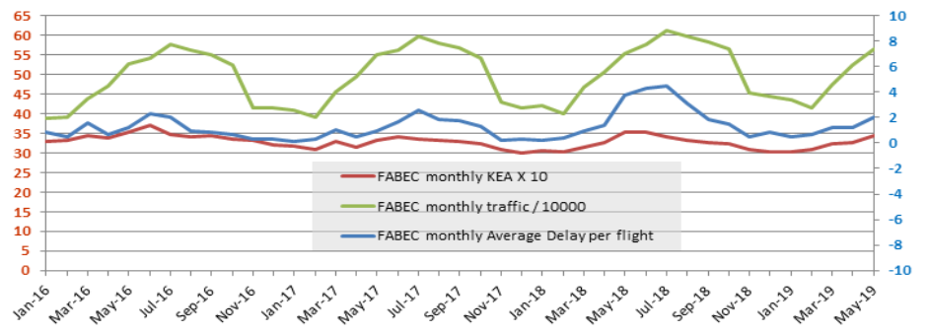
Interdependencies Traffic ./. Delays

Slide 23
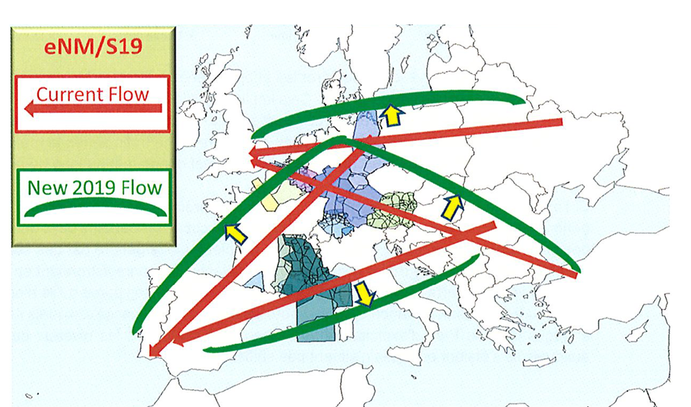
Impact eNM summer plans
Flow w/o eNM
2200 sectors assessed
Any capacity available exploited
19 million minutes of delay mitigated
Limiting as much as possible environmental impact

Slide 24
Uncontrollable factors and interdependencies
Military Activities
Weather
Short-term Capacity Issues
Financial Flight Plan optimisation
Corporate Actions
eNM/S19

Slide 25
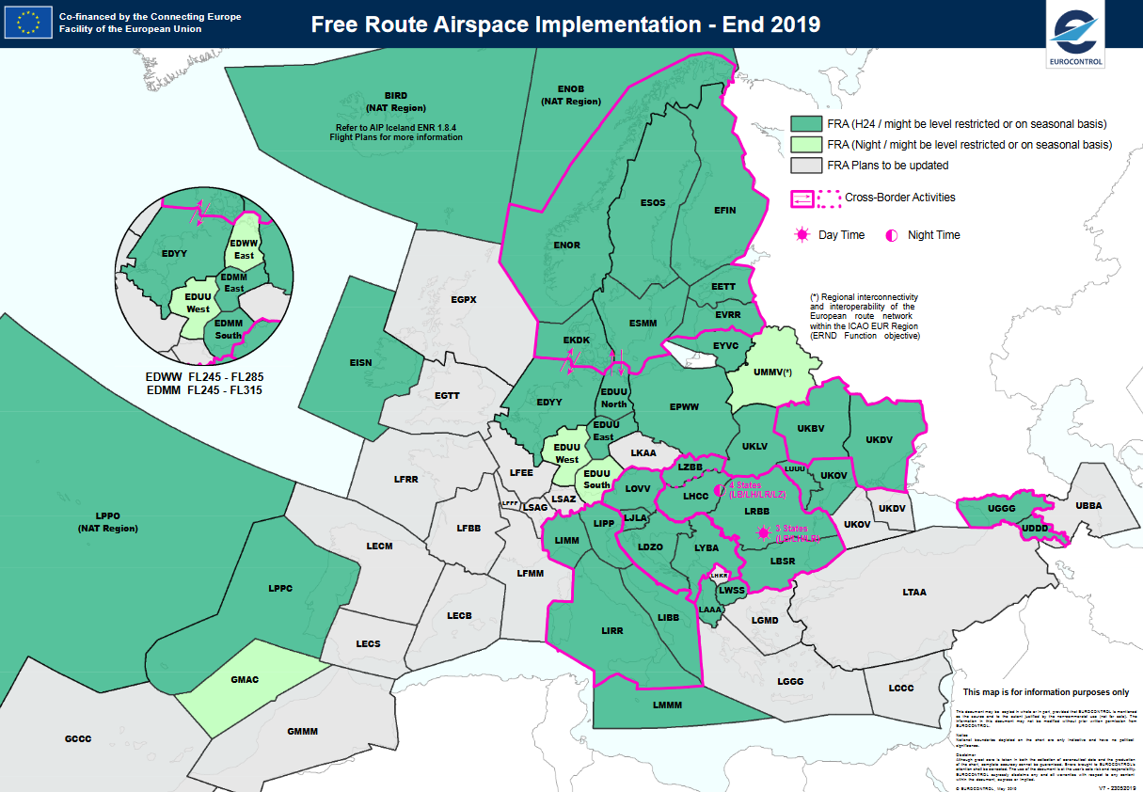
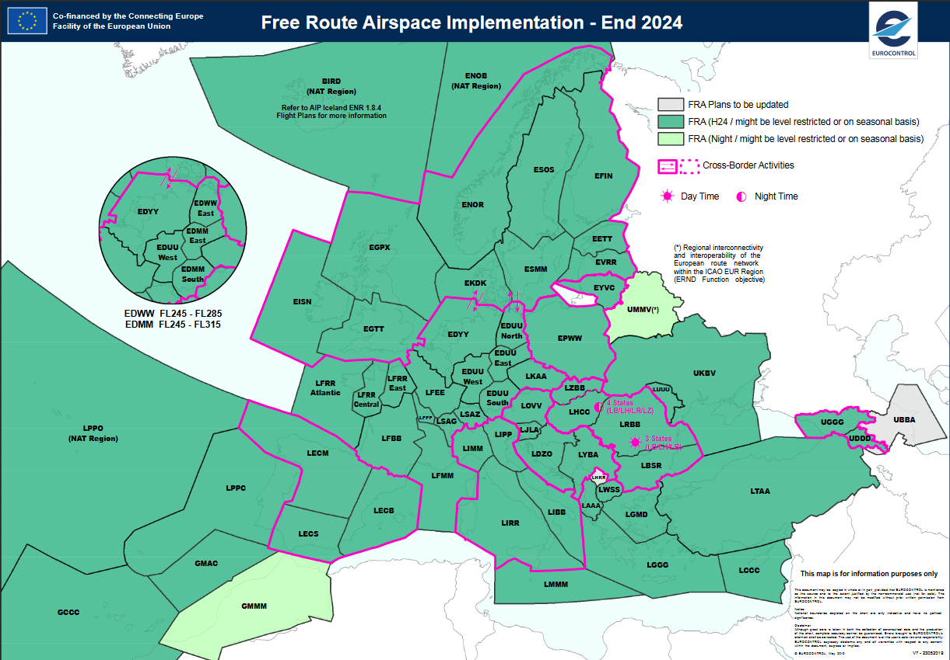
FABEC Main Measures
FABEC FRA implementation
End 2019
End 2024
https://www.eurocontrol.int/sites/default/files/2019-07/ernip-part-2-arn-version-2019-2024.pdf

Slide 26
FABEC Main measures Introduction of Free Route Airspace
2020
Germany Step 2b
2021
Brest ACC
2022
Bordeaux ACC
Marseille ACC
Germany Step 2c
Switzerland H24
2023
Paris ACC
Reims ACC
Notes:
Project Name:
FRA Germany - Step 2b
Description: To permit additional RAD APPENDIX 4 DCTs and implement ATS route changes.
Objective: To prepare the H24 Full FRA implemention - according to PCP requirements - and improve flight efficiency within Karlsruhe UAC/ FABEC.
A Conditional Route may have more than one category, and those categories may change at specified times:
a) Category One - Permanently Plannable CDR:
CDR1 routes are available for flight planning during times published in the relevant national Aeronautical Information Publication (AIP).
b) Category Two - Non-Permanently Plannable CDR:
CDR2 routes may be available for flight planning. Flights may only be planned on a CDR2 in accordance with conditions published daily in the CRAM, and
c) Category Three - Not Plannable CDR:
CDR3 routes are not available for flight planning; however, ATC Units may issue tactical clearances on such route segments.

Slide 27
FABEC - Other main measures FABEC/NM ADCG*
FABEC-initiative to improve airspace structure over RP3 and beyond
Analysis of bottlenecks
Planning towards a FABEC Free Route Airspace
Q3/2019
Discussion of re-sectorisation proposal
Q4/2019
Fine-tuning of the airspace re-sectorisation
Q1/2020
Initial Draft of FABEC airspace structure finalised
Initial Proposal for implementation
COO Workshop
* FABEC – NM Airspace Design Co-ordination Group

Slide 28
FABEC - Other main measures ERNIP Part 2
Summer 2020
France:
Paris ACC re-org West Phase 2
Paris ACC re-org South Phase 2
Reims ACC/ Brest ACC re-sectorisation
Airspace Structure Improvement Marseille ACC
DFL change Marseille ACC
Germany:
Single CDR category (SCC)
DFL355 MUAC BruSG East.
Netherlands
Sector 3 re-design Amsterdam FIR
Switzerland
Single CDR category (SCC).
Summer 2021
France:
Airspace Structure Improvement Reims ACC
Airspace Structure Improvement Bordeaux ACC
ELIXIR Phase 2.
Germany:
Berlin Brandenburg International (BER) airport
Notes:
Project Name:
ELIXIR Phase 2
Description: To implement a new route (or DCT) parallel to UN859 between SITET and LMG/BEBIX -extension of thenew route from SITET.
Objective: To improve London ACC / Brest ACC interface, increase the capability of Brest Q and X sectors to climb UK departures to their RFL, thus increasing capacity on the UK / Southwest of France and Spain flows.

Slide 29
FABEC - Other main measures ERNIP Part 2
Summer 2023
France:
Paris ACC re-organisation - Phase 3
Germany:
3rd RWY Munich airport
Bodensee sector re-design.
End 2024
Belgium
New common ATM system in Belgian airspace.
Germany:
Langen 2.0 Step -UBENO Inbound;
Langen 2.0 Step -BAM Opt;
Langen 2.0 Step -Pre-sorting from the East
Notes:
Project Name:
Paris ACC re-organisation -Phase 3
Description: To re-organise the lower airspace and delegate ATS to APP units belowFL115for relevant airspace in Paris ACC(North West of FIR).
Objective:To further improve the airspace structure within France FIR

Slide 30
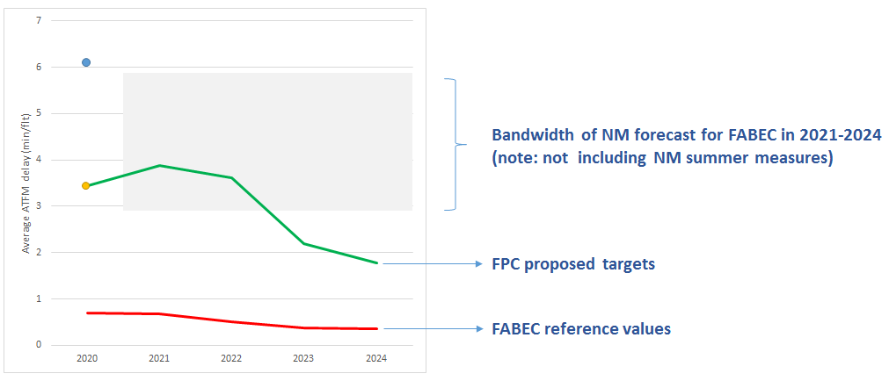
FABEC FPC RP3 Targets proposal
KEA % | 2020 | 2021 | 2022 | 2023 | 2024
EU wide | 2.53 | 2.47 | 2.40 | 2.40 | 2.40
FABEC RV | 2.90 | 2.83 | 2.75 | 2.75 | 2.75
FPC targets | 3.25 | 3.25 | 3.25 | 3.15 | 3.00
Consistent with RP3 capacity targets profile:

Slide 31
FABEC FPC RP3 Local Target & National Breakdown
Min/flight | 2020 |  | 2021 |  | 2022 |  | 2023 |  | 2024
EU wide | 2.53% |  | 2.47% |  | 2.40% |  | 2.40% |  | 2.40%
FABEC RV/Target | 2.90% | 3.25% | 2.83% | 3.25% | 2.75% | 3.25% | 2.75% | 3.15% | 2.75% | 3.00%
LVNL RV | 7.22% | 7.22% | 7.20% | 7.22% | 7.18% | 7.22% | 7.18% | 7.20% | 7.18% | 7.18%
SKEYES RV | 7.09% | 7.12% | 7.09% | 7.12% | 7.05% | 7.12% | 7.05% | 7.12% | 7.05% | 7.12%
DFS RV | 2.81% | 3.24% | 2.73% | 3.24% | 2.65% | 3.24% | 2.65% | 3.10% | 2.65% | 2.95%
DSNA RV | 2.90% | 3.33% | 2.83% | 3.33% | 2.75% | 3.33% | 2.75% | 3.15% | 2.75% | 3.00%
MUAC RV | 1.99% | 2.29% | 1.92% | 2.29% | 1.85% | 2.29% | 1.85% | 2.20% | 1.85% | 2.15%
SKYGUIDE RV | 4.62% | 4.78% | 4.53% | 4.78% | 4.45% | 4.78% | 4.45% | 4.65% | 4.45% | 4.50%

Slide 32
Thank you for your attention
Questions?

Slide 33
Stakeholder consultation meeting on
FABEC RP3 performance plan
Stéphane Lafourcade, FR NSA
Capacity
Luxembourg, 5 September 2019

Slide 34
EU wide capacity Performance targets
KPI definition (annex 1, section 1, paragraph 3.1 of (EU) 2019/317)
“The average minutes of en route ATFM delay per flight attributable to air navigation services, calculated as follows:
The en route ATFM delay is the delay calculated by the Network Manager, expressed as the difference between the estimated take-off time and the calculated take-off time allocated by the Network Manager…
This indicator covers all IFR flights and all ATFM delay causes, excluding exceptional events…
This indicator is calculated for the whole calendar year and for each year of the reference period.”

Slide 35
EU wide capacity Performance targets
FABEC / ANSPs NM Reference Values (RV)
EU wide targets :
Commission implementing decision (EU) 2019/903 of 29 May 2019
setting the Union-wide performance targets for the air traffic management network for the third reference period starting on 1 January 2020 and ending on 31 December 2024.
Reference values:
Local capacity reference values for RP3
published by PRB, 13th March 2019
Min/flight | 2020 | 2021 | 2022 | 2023 | 2024
EU wide | 0.90 | 0.90 | 0.70 | 0.50 | 0.50
FABEC RV | 0.69 | 0.68 | 0.51 | 0.37 | 0.36
SKEYES RV | 0.20 | 0.21 | 0.17 | 0.12 | 0.12
DFS RV | 0.52 | 0.50 | 0.37 | 0.25 | 0.23
DSNA RV | 0.43 | 0.43 | 0.32 | 0.23 | 0.23
LVNL RV | 0.13 | 0.14 | 0.12 | 0.12 | 0.11
MUAC RV | 0.36 | 0.35 | 0.23 | 0.18 | 0.18
SKYGUIDE RV | 0.33 | 0.33 | 0.27 | 0.20 | 0.20

Slide 36
EC statement on performance plans assessment
(EU) 2019/317:
Article 14.1:
“The Commission shall assess the consistency of the national performance targets or FAB performance targets … taking into account local circumstances.”
Annex IV, 1.3 Criteria for capacity assessment:
“ … Comparing the … FAB performance targets with the reference values set out in the latest version of the Network Operations Plan. “
SSC 71 EC Statement:
“Such local circumstances may lead to setting capacity targets in some areas which differ from the reference values calculated by the Network Manager, provided that there is a clear indication that the capacity situation in those areas will improve.”

Slide 37
RP2 FABEC actual capacity achievements:
2014-2018 FABEC performance monitoring reports
10 FABEC ACC (out of 14) in the Top 20 delays Hot spots, mainly due to:
Global traffic increase (+12% since 2015)
Traffic volatility and local traffic shifts (Brest ACC traffic > 20% since 2015)
Lack of ATCOs and investments (RP1&RP2 costs pressure)
Leading to capacity shortage and staffing issues
Growing weather impact

Slide 38
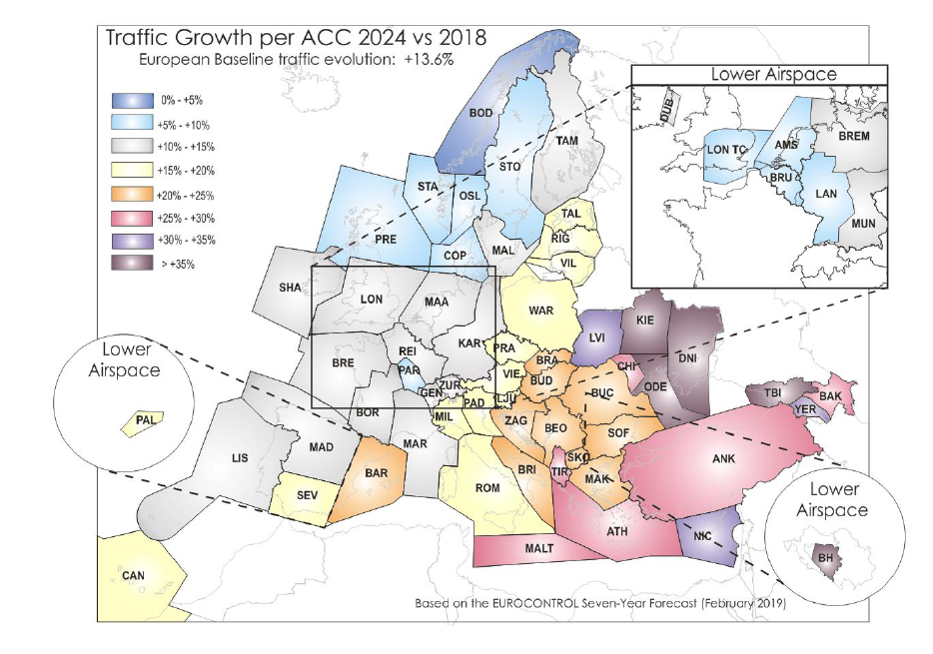
RP3 STATFOR IFR Mvts Growth (February 2019)

Slide 39
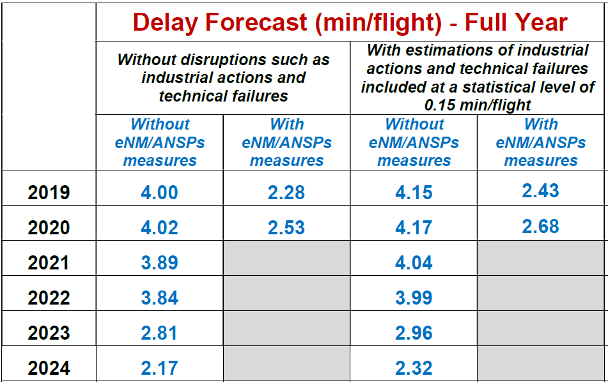
RP3 NM Network Operation Plan April 2019
Basic NOP assumptions:
Baseline traffic scenario,
0.32 min/flight MET buffer
No Post-Ops process delays reallocation forecast,
No daily NM/FMP ATFM measures forecast nor eNM/ANSPs impact after 2020
EUROCONTROL Zone

Slide 40
RP3 NM Network Operation Plan April 2019
Decision (EU) 2019/903, 29th May 2019, provides EU wide targets.
Local capacity reference values for RP3 published by PRB, 13th March 2019.
NOP 2019 – 2024 April 2019 provides:
Delays forecast ranges for FABEC and its individual ANSPs
Estimated impact of potential eNM/S20 summer plan
Min/flight | 2020 | 2021 | 2022 | 2023 | 2024
EU wide | 0.90 | 0.90 | 0.70 | 0.50 | 0.50
FABEC RV | 0.69 | 0.68 | 0.51 | 0.37 | 0.36
FABEC RV / NOP | 0.69 /6.13 | 0.68 / 2.91-5.88 | 0.51 / 2.91-5.88 | 0.37 / 2.91-5.88 | 0.36 / 2.91-5.88
FABEC RV / NOP eNM | 0.69/ 3.47 | 0.68 | 0.51 | 0.37 | 0.36

Slide 41
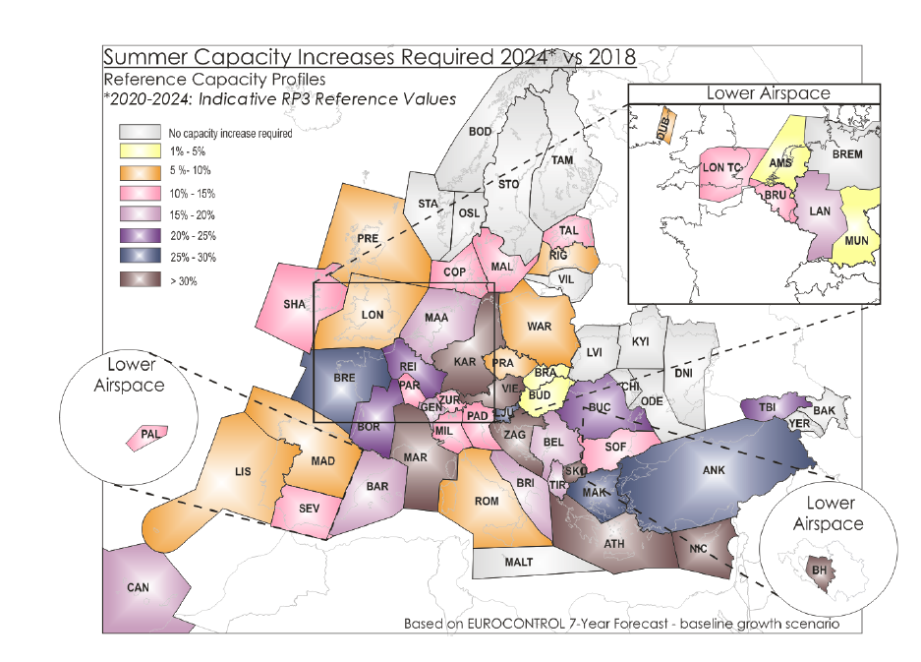
RP3 Network Operation Plan April 2019 main challenge: Addressing RP3 capacity gap

Slide 42
Main RP3 measures to enhance capacity
(exhaustive list of measures in NOP)
Tech
Main ANSPs implementation providing additional capacity:
S-ATM for DFS and ICAS for DFS&LVNL,
DLS and 4-FLIGHT for DSNA,
new ATM in CANAC2 for skeyes.
Staff issues mitigation:
ATCO hiring in all ANSPs,
More flexible rostering,
Changes in training (reduced duration),
Spaces under FL 195 transfered to approaches.
Continuation of eNM/ANSPs/S19 plan (or similar) after 2020
FABEC Airspace redesign:
On going Swiss ACCs resectorizations,
NM&FABEC Airspace Design Coordination Group.
Enhanced FUA within FABEC area
HR
Net

Slide 43
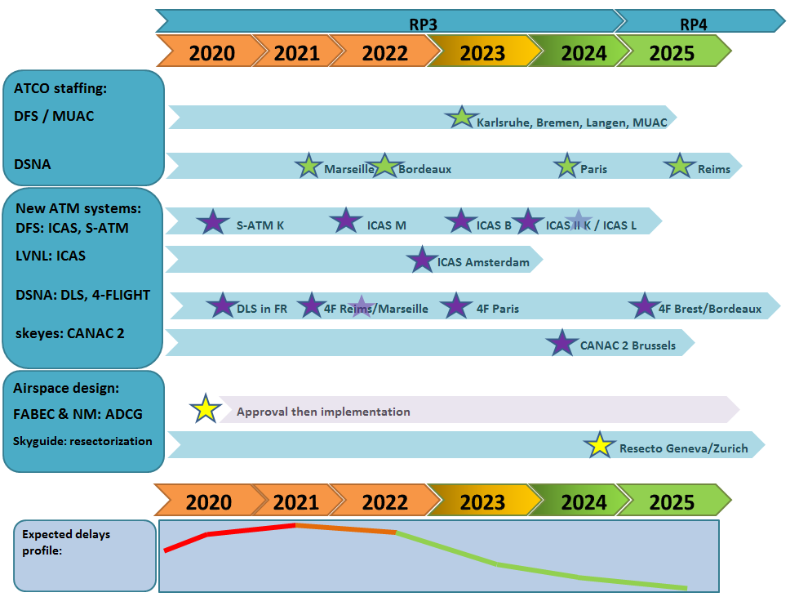
Mains RP3 measures to enhance capacity
Timeline and impact on FABEC capacity profile

Slide 44
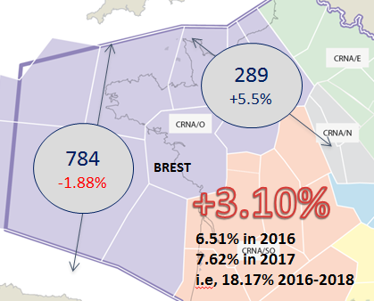
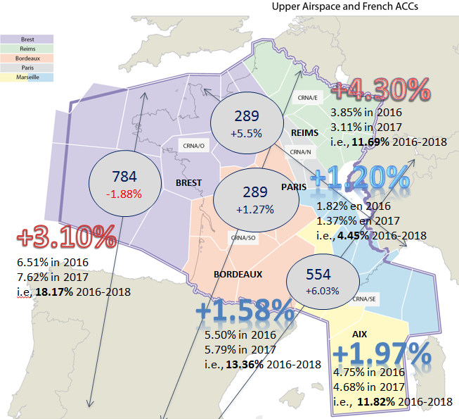
RP3 Capacity: towards target setting
Uncertainties to be considered
Regarding traffic
Actual traffic versus forecast and traffic volatility (Brest example 2015 – 2018)
Exponantial impact on delays of the traffic evolution as soon as the traffic approaches the capacity limit of an ACC
Impact of eNM/ANSPs type measures post 2020
Will be continued? Need NM, other ANSP, AU acceptance: impact on fuel consumption, level capping, ANSP revenues, flight efficiency…
Magnitude of impact on delays?
Post-ops process delays reallocation to FABEC?

Slide 45
RP3 Capacity: towards target setting
Uncertainties to be considered
Regarding staffing issues mitigation measures:
Competitiveness of ATCO recruitments (some ANSPs are currently facing difficulties)
Increased ATCO training complexity and lower conversion rates
New social agreements needed to ensure new rostering and working arrangements
Regarding systems implementation:
Availability of revenues to finance investments plan (interdependencies with cost-efficiency and traffic evolution)
Timely systems implementation and impact on capacity of training, validation and implementation phases
Actual capacity benefits versus expected benefits

Slide 46
RP3 Capacity: Proposed capacity targets
FABEC States consider that
EU wide capacity target remains highly challenging and FABEC NM reference values are unachievable
EC has agreed that «local circumstances may lead to setting capacity targets in some areas which differ from the reference values» provided «there is a clear indication that the capacity situation in those areas will improve»
RP3 is a transition phase enabling implementation of a full set of technical, HR and airspace redesign measures to recover FABEC capacity in RP4
Major uncertainties shall be taken into account
Proposed targets should provide right balance between being achievable and meeting aspirational EU targets.
FABEC States propose to set RP3 capacity performance targets as follows
RP3 | 2020 | 2021 | 2022 | 2023 | 2024
Target (min/flight) | 3.45 | 3.88 | 3.61 | 2.19 | 1.78

Slide 47
RP3 Capacity targets FPC proposal vs NOP forecast

Slide 48
RP3 Capacity: FABEC Proposed capacity targets
FABEC States consider that proposed targets:
Are set below current FABEC NOP forecast for 2024
Are challenging for major FABEC ANSPs
Provide a -50% delays reduction between 2022 and 2024 mainly thanks to new ATM systems implementation and ATCO hiring
Include no buffer for disruption (industrial action, technical failure, exceptional meteorological event)
Need continued cooperation with NM post 2020 to remain achievable

Slide 49
Thank you for your attention
Questions?

Slide 50
Stakeholder consultation meeting on
FABEC RP3 performance plan
Ana Salas, CH NSA
Cost-Efficiency
Luxembourg, 5 September 2019

Slide 51
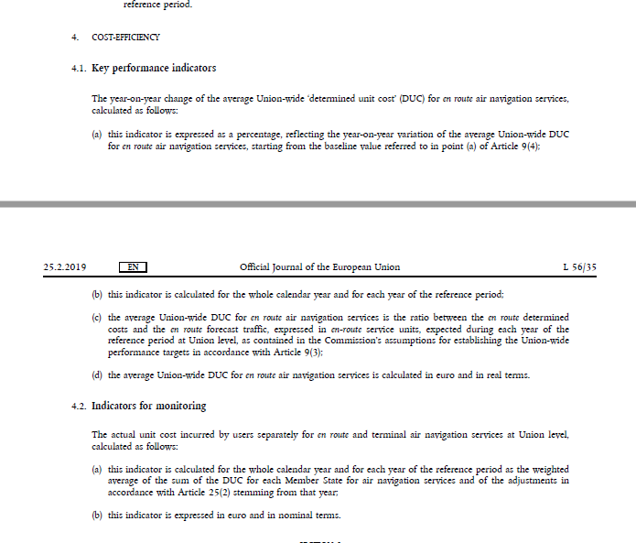
Key performance indicator definition
EU 2019/317 – Annex I, Section 1, Paragraph 4.1.
4.1. Key performance indicators
The year-on-year change of the average Union-wide ‘determined unit cost’ (DUC) for en route air navigation services, calculated as follows:
this indicator is expressed as a percentage, reflecting the year-on-year variation of the average Union-wide DUC for en route air navigation services, starting from the baseline value referred to in point (a) of Article 9(4);
b) this indicator is calculated for the whole calendar year and for each year of the reference period;

Slide 52
EU-wide target
EU wide targets :
Commission implementing decision (EU) 2019/903 of 29 May 2019
setting the Union-wide performance targets for the air traffic management network for the third reference period starting on 1 January 2020 and ending on 31 December 2024.
Article 5
1. Union-wide performance targets for the key performance area of cost-efficiency, as defined in point 4.1 of Section 1 of Annex I to Implementing Regulation (EU) 2019/317, shall be a year-on-year change of the average Union- wide determined unit cost for en route air navigation services of – 1,9 % for 2020, – 1,9 % for 2021, – 1,9 % for 2022, – 1,9 % for 2023 and – 1,9 % for 2024. The year-on-year change shall be calculated starting from the baseline value for the determined unit cost set in paragraph 3.
Union-wide CE target | 2020 | 2021 | 2022 | 2023 | 2024
Average Union-wide determined unit cost for en route ANS | -1.9% | -1.9% | -1.9% | -1.9% | -1.9%

Slide 53
Cost Efficiency
Cost efficiency targets have been already consulted at national level in FABEC.
2th July – Netherlands
4th July – France
21th August – Germany
28th August – Switzerland
29th August – Belgium and Luxembourg
3rd September - Luxembourg

Slide 54
Cost Efficiency RP3
RP3 is a period with major developments planned in the main pillars of air navigation services such as Airspace, technology, airport, institutional, human factor and safety although FABEC.
Implementation of new ATM systems or upgrades of legacy systems will take place in RP3.
Recruiting: ATCO hiring plans, more flexible rostering and new working conditions for ATCO.
Benefits will be visible in RP3 and following RP4

Slide 55
Cost Efficiency RP3
SSC 71
“As regards the targets in the key performance area of cost-efficiency, the Commission recalls the assessment criteria set out in point 1.4(d)(i) of Annex IV to Commission Implementing Regulation (EU) 2019/317, which allows a deviation from the criteria set out in points (a) to (c) in order to allow the achievement of performance targets in the key performance area of capacity…”

Slide 56
Aggregated global figure (last available data)
FABEC real en route unit cost (€2017) | 2020 D | 2021 D | 2022 D | 2023 D | 2024 D | CAGR 20/24 | CAGR 19/24 | CAGR 14/24
Belgium-Luxembourg | 86.42 | 88.39 | 90.47 | 91.24 | 91.31 | 1.39% | 1.94% | 2.94%
France | 58.20 | 57.70 | 56.80 | 56.12 | 55.84 | -1.03% | -1.15% | -1.54%
Germany | 69.05 | 68.64 | 64.97 | 63.98 | 62.99 | -2.27% | -0.27% | -2.34%
Netherlands | 67.62 | 66.74 | 65.75 | 66.51 | 66.37 | -0.47% | 0.55% | 0.05%
Switzerland | 98.74 | 95.58 | 90.81 | 87.33 | 84.51 | -3.81% | -1.01% | -1.66%
Aggregated weighted average | 65.80 | 65.35 | 63.52 | 62.83 | 62.24 | -1.38% | -0.46% | -1.41%
 | 3.3% | -0.7% | -2.8% | -1.1% | -0.9%

Slide 57
Thank you for your attention

Slide 58
Stakeholder consultation meeting on
FABEC RP3 performance plan
Jean-Jacques Blanchard, FR NSA
En route Incentive Scheme
Luxembourg, 5 September 2019

Slide 59
Regulatory framework - IR (EU) 2019/317 of 11 February 2019
Article 11 – Incentive schemes
- applied during the entire period covered by the performance plan - non-discriminatory, transparent and effective
- proportionate to the level of ATFM delay - symmetric range around the pivot value - maximum penalty at least equal to the maximum bonus - only ANSP(s) involved in reference to the FABEC performance - modulation mechanism at FABEC and ANSP level in a uniform manner
ANNEX XIII - SPECIFIC REQUIREMENTS REFERRED TO IN ARTICLE 11(3)
Modulation of pivot values (November NOP release of year n-1, CRSTMP ER ATFM delay causes)
Calculation of financial advantages and disadvantages (% of the determined costs of year n and recovered from/reimbursed to airspace users through an increase/a reduction of the unit rate in year n+2)

Slide 60
FABEC En route Incentive Scheme
FABEC level – Trigger mechanism
Depending on the FABEC performance compared to the FABEC pivot value
Bonus No bonus nor Penalty Penalty
In case of a bonus at FABEC level, only those ANSPs that have performed better than their expected contribution (beyond the dead-band) are awarded a bonus
In case of a penalty at FABEC level, only those ANSPs that have performed worse than their expected contribution (beyond the dead-band) are awarded a penalty
ANSP level – Calculation of bonus or penalty, if any
Bonus: a percentage of the determined costs of year n and recovered from airspace users through an increase of the unit rate in year n+2
Penalty: a percentage of the determined costs of year n and reimbursed to airspace users through a reduction of the unit rate in year n+2

Slide 61
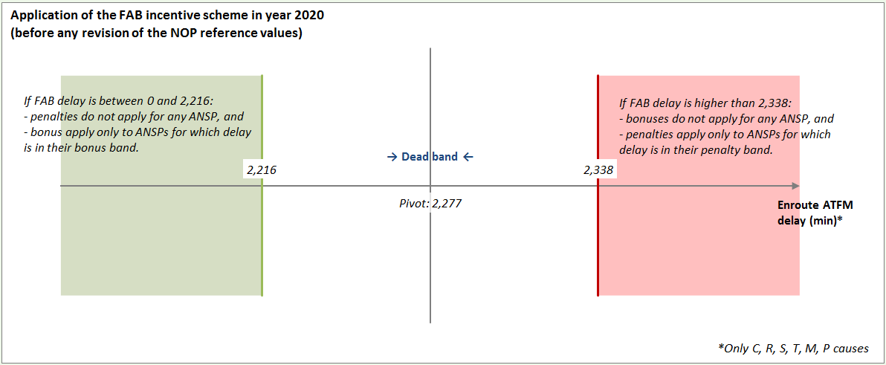
FABEC level – Trigger mechanism
Pivot Value

Slide 62
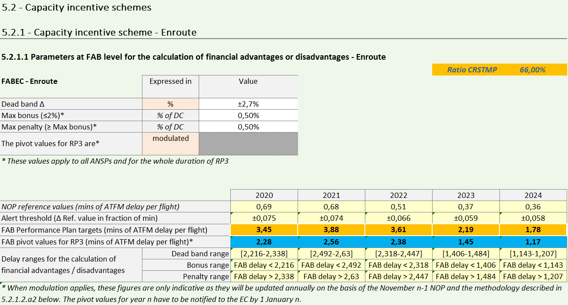
FABEC level – Trigger mechanism
Based on RP2 historical data
Symmetric range around Pivot value
Max Bonus = Max Penalty
Modulation mechanism
All causes
CRSTMP causes

Slide 63
ANSP level – Breakdown FABEC Capacity target per ANSP
Need to get the pivot value at ANSP level for calculating bonus or penalty, if any
Only CRSTMP en route ATFM delay causes to take into account for the pivot value
Pivot values
Pivot values
Pivot values
Pivot values
Pivot values
Pivot values
Pivot values

Slide 64
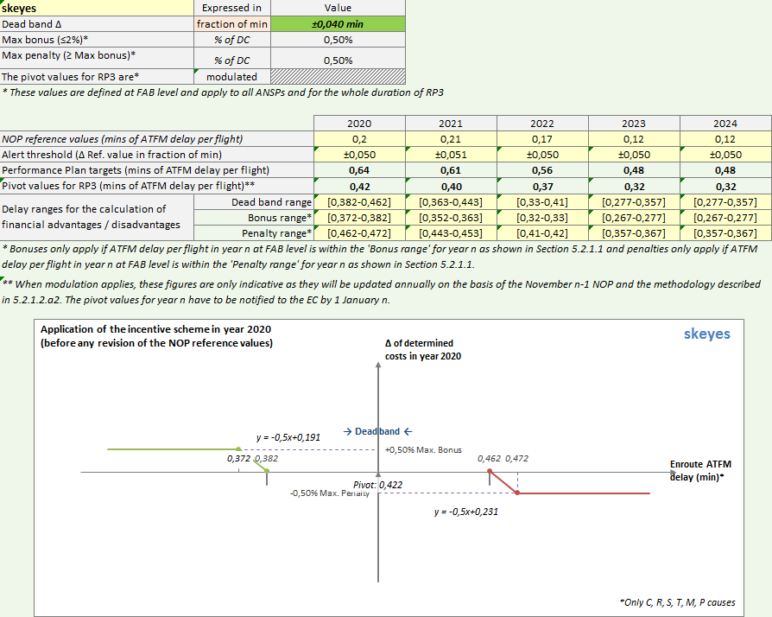
ANSP level – Calculation of bonus or penalty, if any
Set up by NSA
Example of a
dead-band
expressed in
fraction of min.
All causes (breakdown)
CRSTMP causes

Slide 65
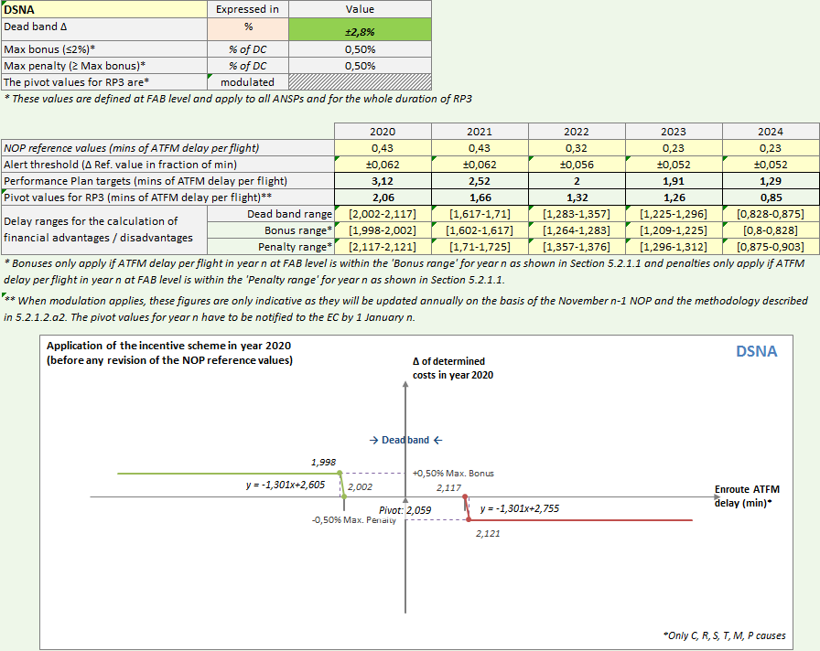
ANSP level – Calculation of bonus or penalty, if any
Set up by NSA
Example of a
dead-band
expressed in
percentage
All causes (breakdown)
CRSTMP causes

Slide 66
Main characteristics of FABEC en route incentive scheme
Performance at FABEC level will trigger a bonus or penalty, if any
In case of a bonus at FABEC level, only those ANSPs that have performed better than their expected contribution (beyond the dead-band) are awarded a bonus
In case of a penalty at FABEC level, only those ANSPs that have performed worse than their expected contribution (beyond the dead-band) are awarded a penalty
Main parameters
Dead-band as a symmetric range around the pivot value set at 2.7% at FABEC level and set by each NSA at ANSP level (expressed in percentage or in fraction of minute)
Maximum bonus and penalty set at 0.5% of determined costs at ANSP level
Modulation mechanism
Limit the scope of incentives to cover only CRSTMP en route ATFM delay causes
Enable significant and unforeseen changes in traffic by updating the Pivot Value based on the annual trend of the Reference Value (value from NOP when FABEC performance plan is established vs figure from November NOP release of year n-1)
=> FABEC en route incentive scheme proposed for RP3 is very similar to the actual one in RP2

Slide 67
Proposed FABEC modulation mechanism
Scope of incentives to cover only CRSTMP en route ATFM delay causes
Pivot value (pv) to be updated by the trend (RV / RV _{pp}) => Pivot Value PV
The reference value (RV _{n}) at FABEC level or ANSP level is provided each year by the November release of year n-1 of the NOP
The modulation mechanism is defined in the performance plan and shall apply for each year of RP3 and shall not be changed during RP3 at FABEC and ANSP level
PV n = pvpp n ^ (RV n / RVpp n)
All causes
CRSTMP causes

Slide 68
Thank you for your attention
Questions?

